Slide 1

Introduction to Blockchain
Raghu Prasad Konandur
CEO
www.kaushalya.tech
9845547471
raghuprasadkonandur@kaushalya.tech

Slide 2
Introduction
Raghu Prasad – BE, MS
Total of 30 years of experience
7 years as a lecturer in an Engineering College
23 Years into IT
Worked with companies like CISCO,CSC,ICICI,First Apex – NTT Data
Currently into Corporate training and consultancy
Worked with corporates and public sector
Service Offerings – In person/On-line/Corporate/Academic Institutes
Consultancy – Consultant to vendor of Atal Tinkering Lab/ECIL-ECIT, Incarnus – Healthcare Service Provider, Automation Spectrum Pty Ltd,Australia,Tech Varaha,Bengaluru
Technologies – Java,Python,Web technologies,Java Script technologies (MEAN stack),IOT,Test Automation,Machine Learning,Artificial Intelligence,Blockchain,NLP,Cyber Security and ERP
Corporate Customers – IQVIA,ITC Infotech,Philips,L & T,Sony,NextGen,Incarnus,Aspire system,Netwoven,SkillUpRight
Academic Customers - BGS-IT,Sindhi College,Malnad Enginering College,S B College of Management, REVA University,Nagarjuna Engineering College,Dayanand Sagar University,Acharya Institute of Technology,NIE Mysore,NIT-Imphal, AMC College, Kristu Jayanti College,SIT Tumakuru,etc

Slide 3
Topics
Introduction to Blockchain
Applications of Blockchain
Blockchain Architecture
Blockchain Ecosystem

Slide 4
What is Blockchain ?
Blockchain is a system of recording information in a way that makes it difficult or impossible to change, hack, or cheat the system.
A blockchain is essentially a digital ledger of transactions that is duplicated and distributed across the entire network of computer systems on the blockchain. Each block in the chain contains a number of transactions, and every time a new transaction occurs on the blockchain, a record of that transaction is added to every participant’s ledger. The decentralized database managed by multiple participants is known as Distributed Ledger Technology (DLT). Blockchain is a type of DLT.
Blockchain is a type of DLT in which transactions are recorded with an immutable cryptographic signature called a hash.
This means if one block in one chain was changed, it would be immediately apparent it had been tampered with. If hackers wanted to corrupt a blockchain system, they would have to change every block in the chain, across all of the distributed versions of the chain.
Blockchains such as Bitcoin and Ethereum are constantly and continually growing as blocks are being added to the chain, which significantly adds to the security of the ledger.

Slide 5
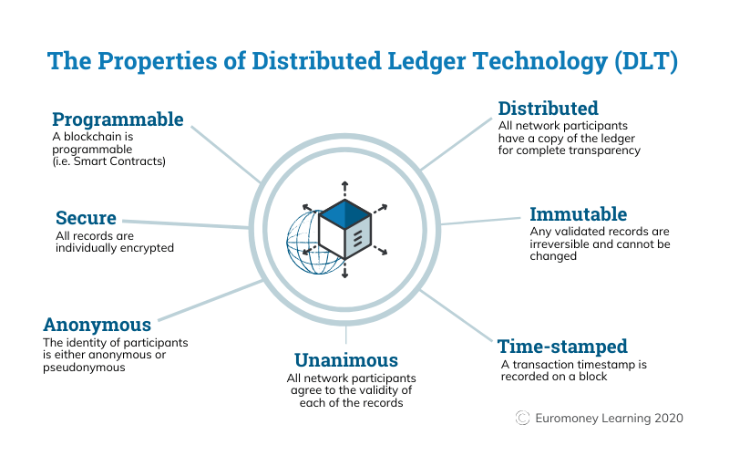
What is Blockchain ?

Slide 6
What is Blockchain ?
Wikipedia Definition
A blockchain is a decentralized, distributed, and oftentimes public, digital ledger consisting of records called blocks that is used to record transactions across many computers so that any involved block cannot be altered retroactively, without the alteration of all subsequent blocks
This allows the participants to verify and audit transactions independently and relatively inexpensively.
A blockchain database is managed autonomously using a peer-to-peer network and a distributed timestamping server.
They are authenticated by mass collaboration powered by collective self-interests.Such a design facilitates robust workflow where participants' uncertainty regarding data security is marginal

Slide 7
What is Blockchain ?
A blockchain can be seen as consisting of several layers:
infrastructure (hardware)
networking (node discovery, information propagation and verification)
consensus (proof of work, proof of stake)
data (blocks, transactions)
application (smart contracts/decentralized applications, if applicable)

Slide 8
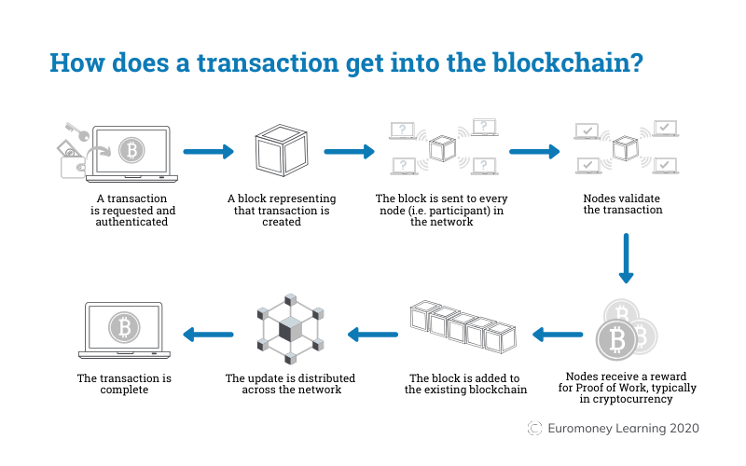
How transactions get into Blockchain ?

Slide 9
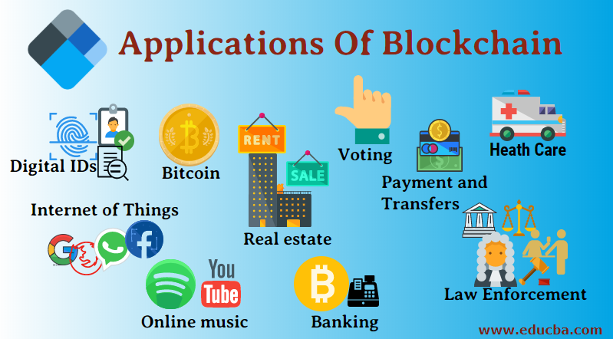
Applications of blockchain

Slide 10
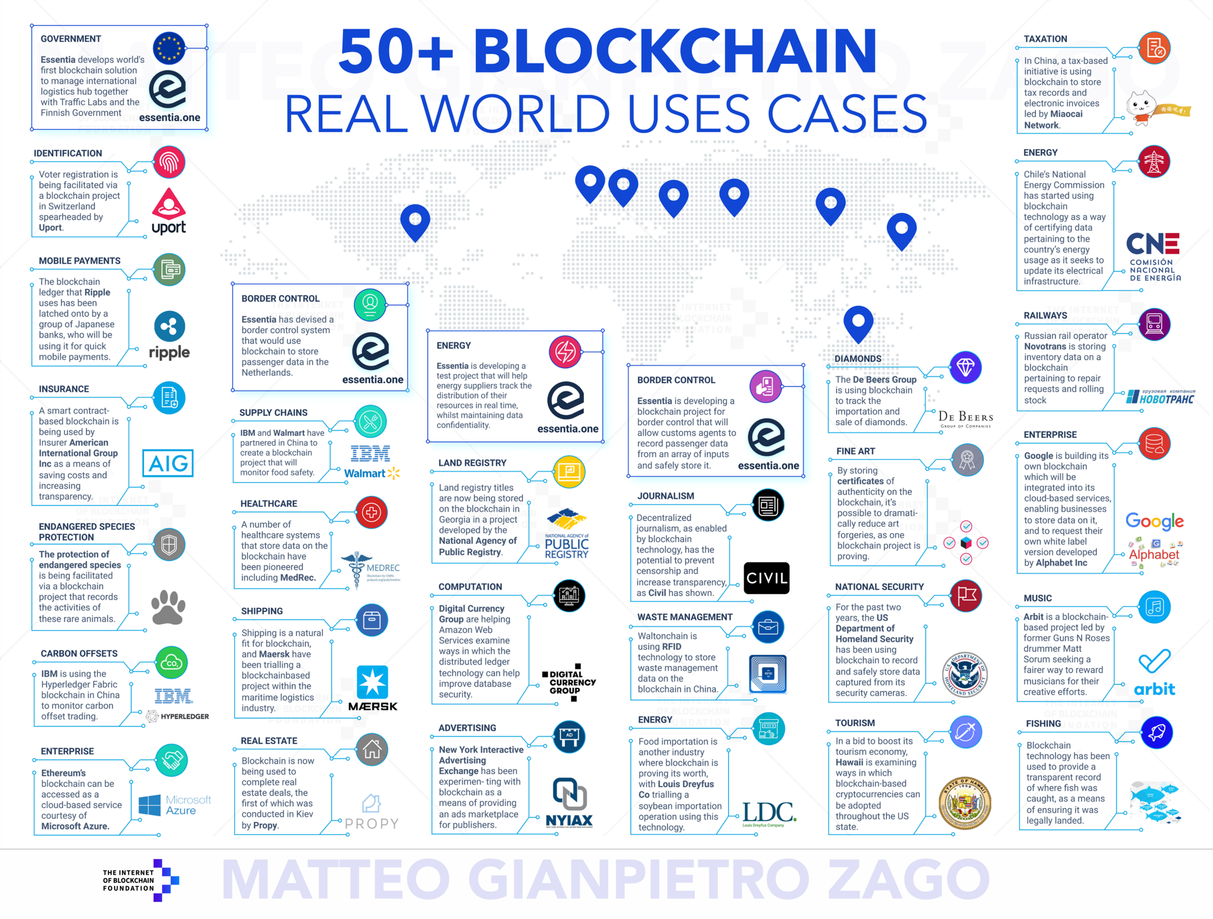
50+ Blockchain Real World Use Cases

Slide 11
50+ Blockchain Real World Use Cases
https://medium.com/@essentia1/50-examples-of-how-blockchains-are-taking-over-the-world-4276bf488a4b

Slide 12
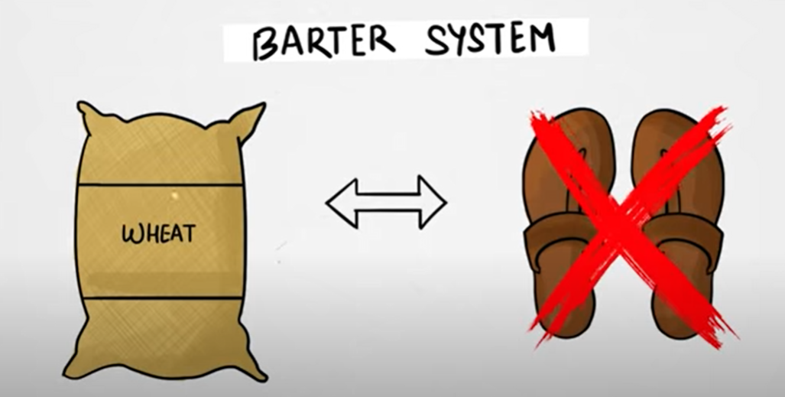
Evolution of Crypto currency
1. Barter System – Problem (Finding exact match)

Slide 13
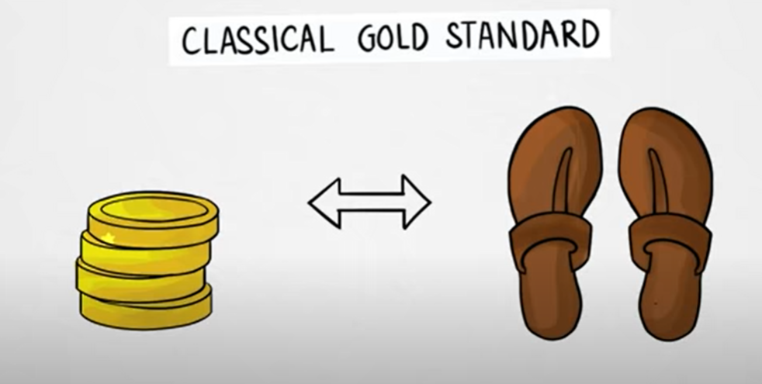
Evolution of Crypto currency
2. Gold coins – Problem (Carrying gold)

Slide 14
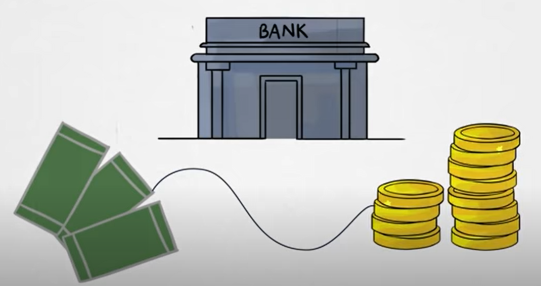
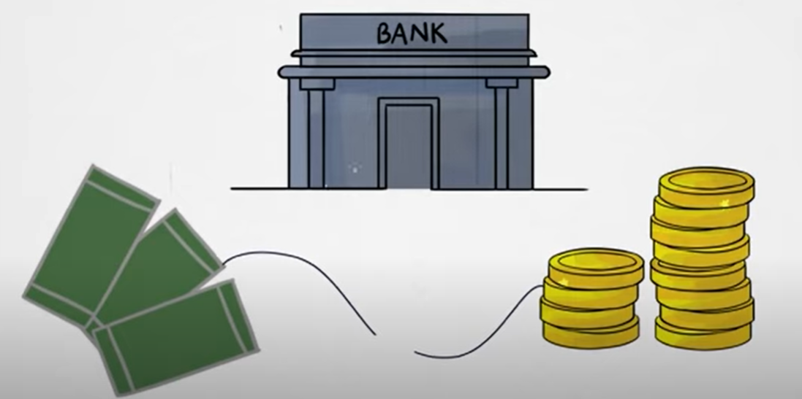
Evolution of Crypto currency
3. Currency based on gold – Problem (Due to worldwar currency printing not linked with gold)

Slide 15
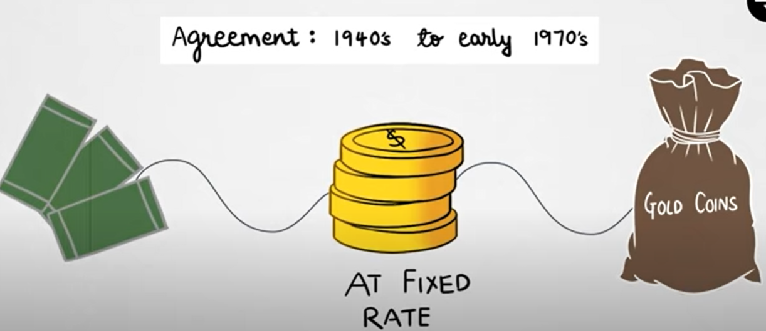
Evolution of Crypto currency
4. Currency based on USD – Problem (Fixed Rate)

Slide 16
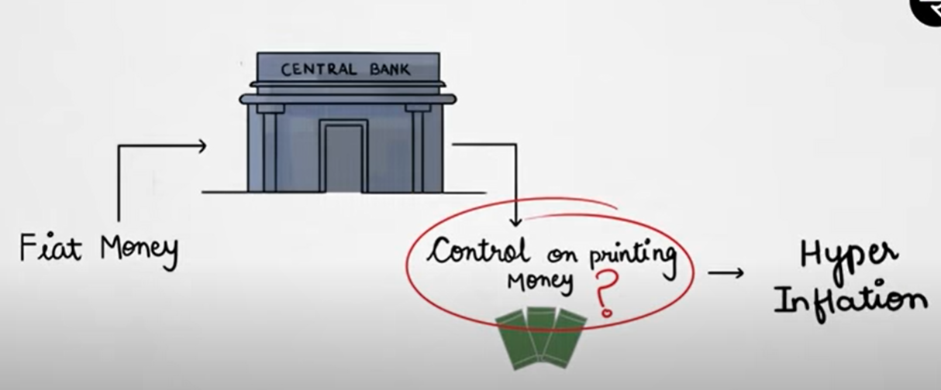
Evolution of Crypto currency
4. Fiat Money – Problem (Hyper inflation)

Slide 17
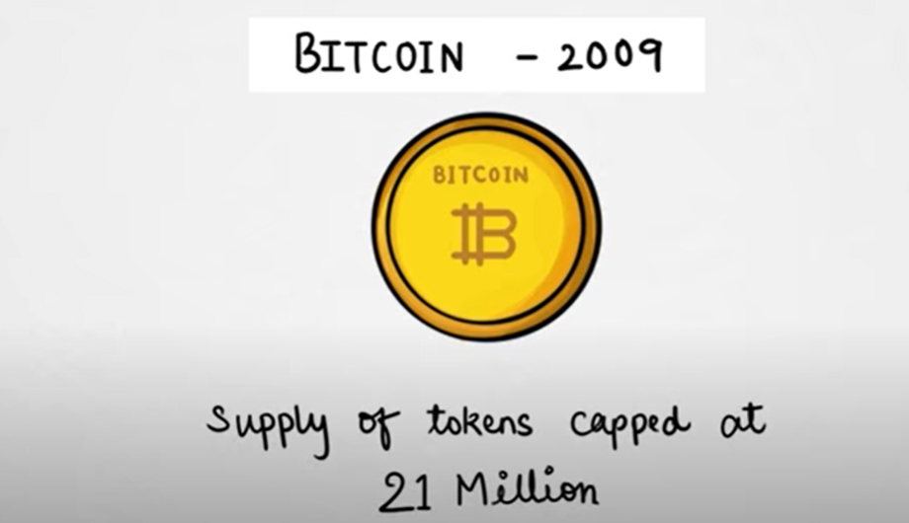
Evolution of Crypto currency
5. Bitcoin with limited availability

Slide 18
Evolution of Crypto currency
Key Attributes of currency
Scarcity
Divisibility
Fungibility (exchange)
Transportability
Durability
Counterfeitability

Slide 19
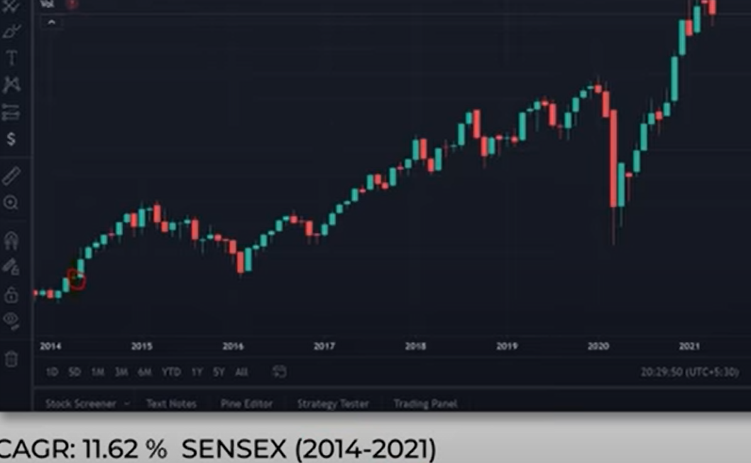
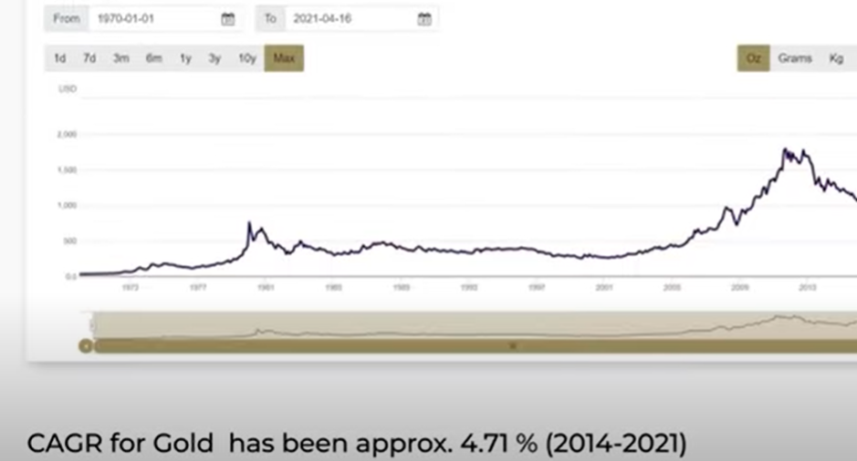
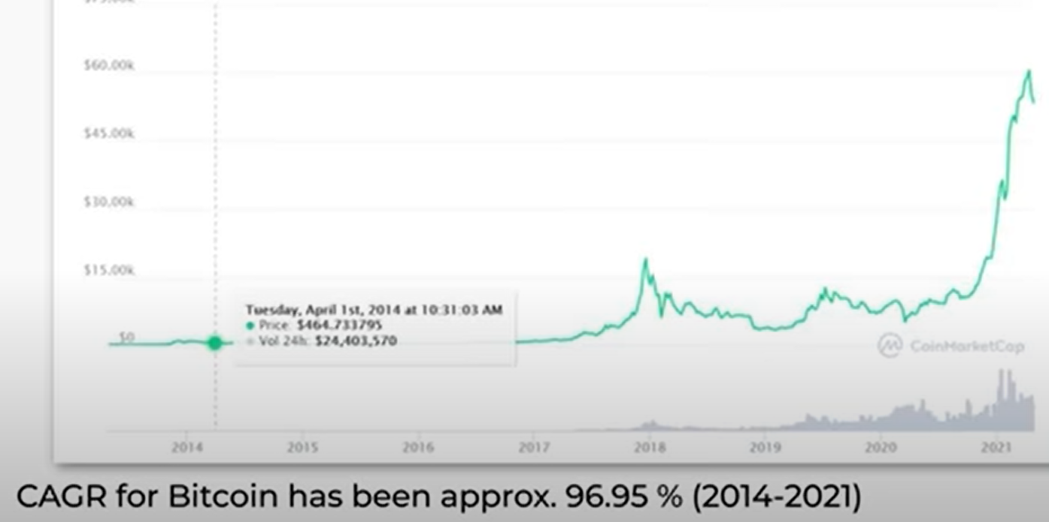
Comparison of returns- compared to inflation of 5 to 6 %

Slide 20
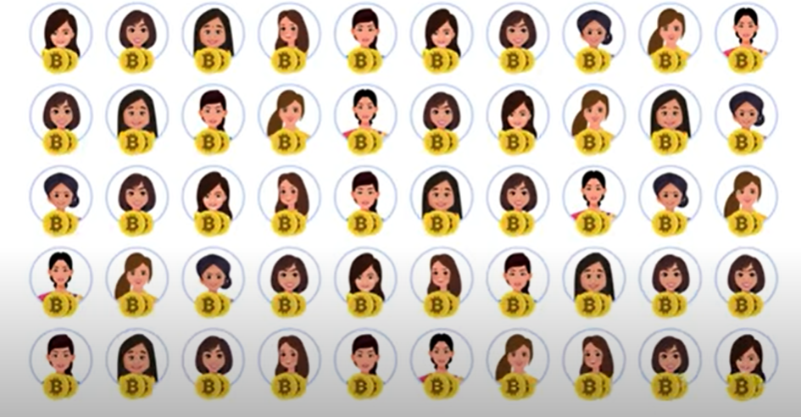
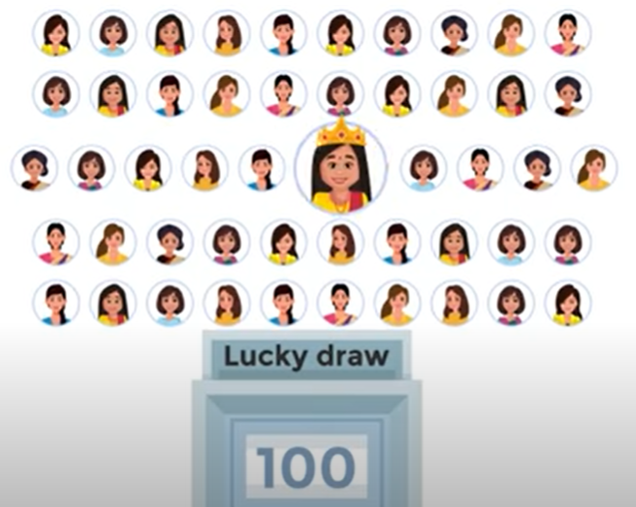
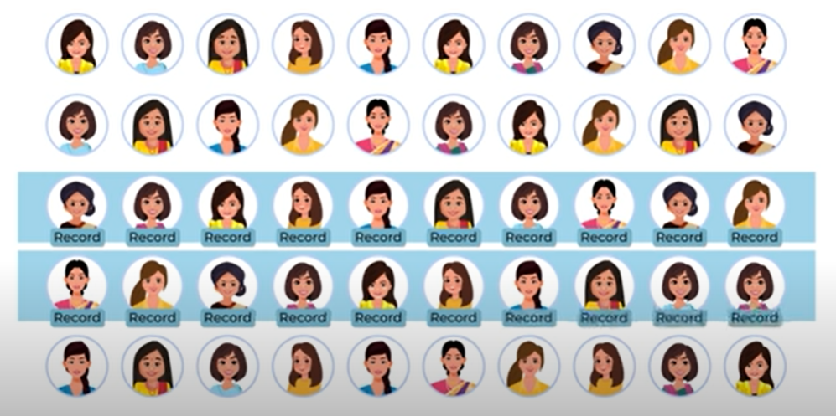
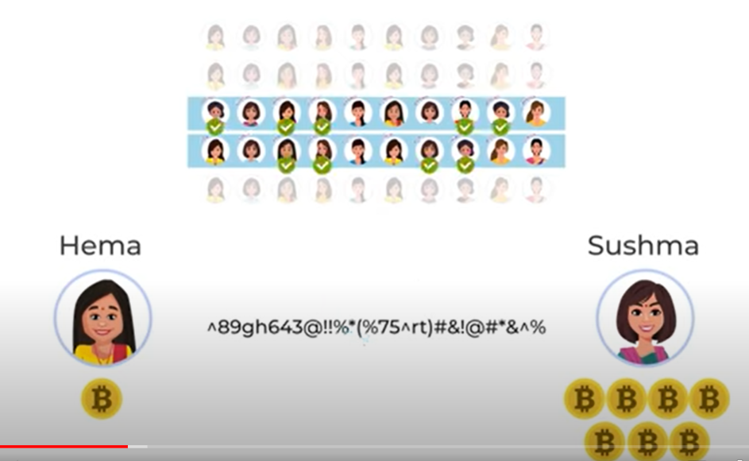
Sample example of blockchain – kitty party

Slide 21
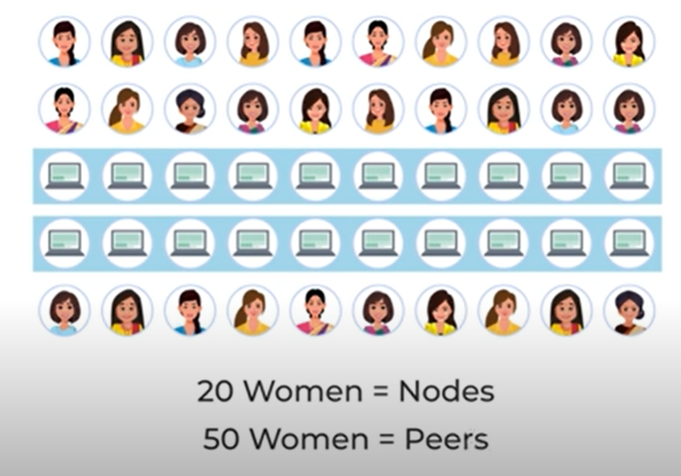
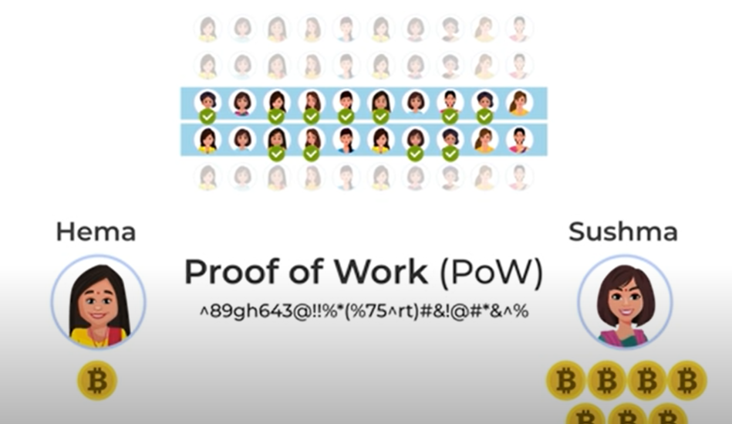
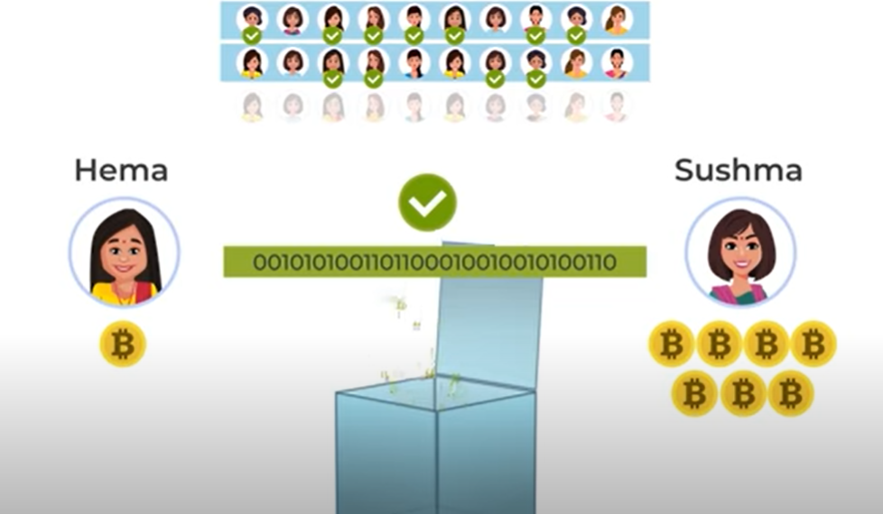
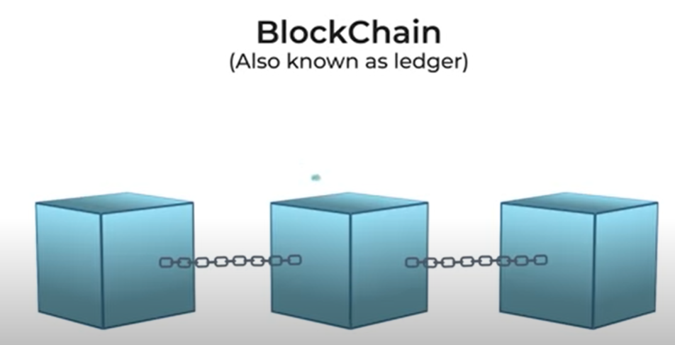
Sample example of blockchain – kitty party

Slide 22
5 elements of creating a blockchain
Peer-to-Peer Network
Cryptography
Consensus Algorithm
Punishment Reward
Market Adoption
https://coinmarketcap.com/

Slide 23
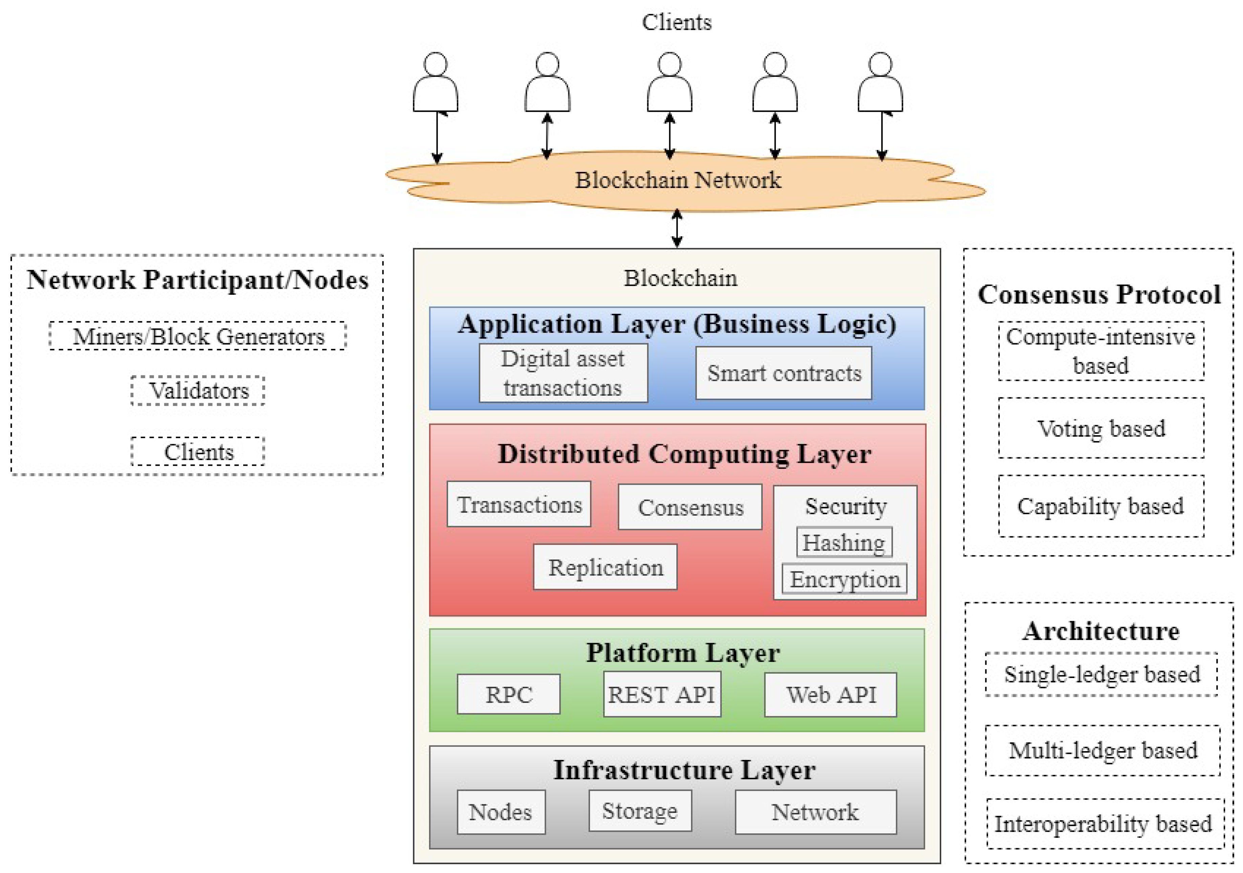
Blockchain Architecture

Slide 24
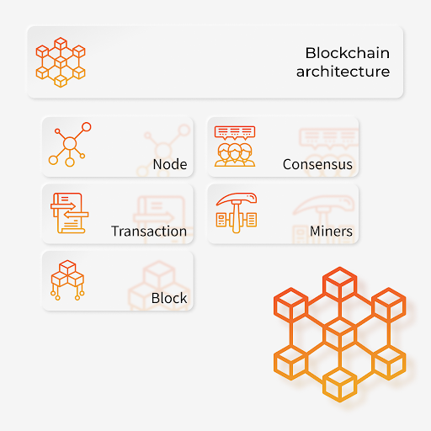
Blockchain Architecture

Slide 25
Thank You
Raghu Prasad Konandur
9845547471
www.kaushalya.tech
raghuprasadkonandur@kaushalya.tech

